Slide 1
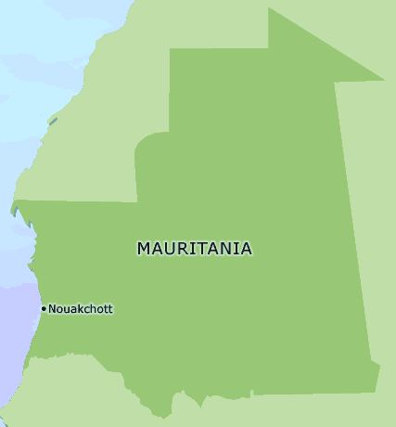
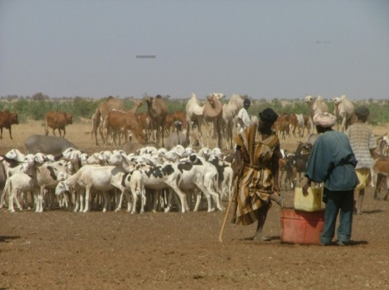
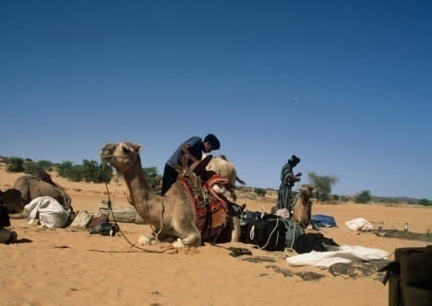
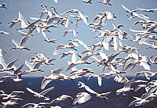
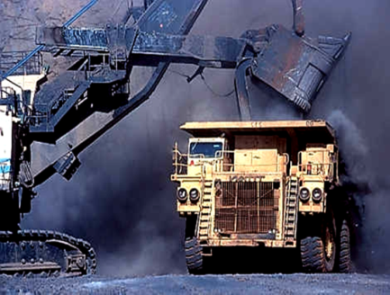
MAURITANIA
INVESTMENT CLIMATE AND OPPORTUNITIES IN MAURITANIA
مــوريتــــانــيـــا
نواكشوط
MARCH 2013

Slide 2
SUMMARY
INVESTMENT CLIMATE
INVESTMENT OPPORTUNITIES
FOCUS: NOUADHIBOU FREE ZONE

Slide 3
INVESTMENT CLIMATE
Macreconomic Indicators
INDICATORS | 2010 | 2011 | 2012 | 2013°
GDP Growth Rate (%) | 5.1 | 4.0 | 6.2 | 6.3
Inflation Rate (%) | 6.1 | 5.5 | 4.7 | 6.0
Foreign Reserves (Months) | 2.5 | 3.7 | 6.0 | 6.6
Fiscal Deficit (% of GDP) | -2.0 | -1.5 | 0.4 | -1.8
Trade Balance (% of GDP) | 2.71 | 7.05 | -2.27 | -9.46

Slide 4
INVESTMENT CLIMATE
Conducive Business Environment
Well Established Democratic system
Independant Judiciary System
Modern Infrastructure
Financial System in transformation
Arbitration Center
Attractive Investment Legislation

Slide 5
INVESTMENT CLIMATE
INVESTMENT ACT
Equal treatment of Foreign and Local Investors
100% foreign ownership allowed
Free transfer of capital, profits and revenue
Protection against expropriation and nationalization
Tax exemptions

Slide 6
INVESTMENT OPPORTUNITIES
FOOD SECURITY
REAL ESTATE DEVELOPMENT
NATURAL RESOURCES
RENEWABLE ENERGIES
ICT
FREE ZONES

Slide 7
NOUADHIBOU FREE ZONE
zoom

Slide 8
Nouadhibou free zone
Nouadhibou Bay
Presented at New Delhi on March 18th, 2013

Slide 9
Outline of the presentation
Advantages of the Nouadhibou Bay
An ambitious vision
Legal and institutional Framework
Multiple investment opportunities

Slide 10
Advantages of the Nouadhibou Bay

Slide 11
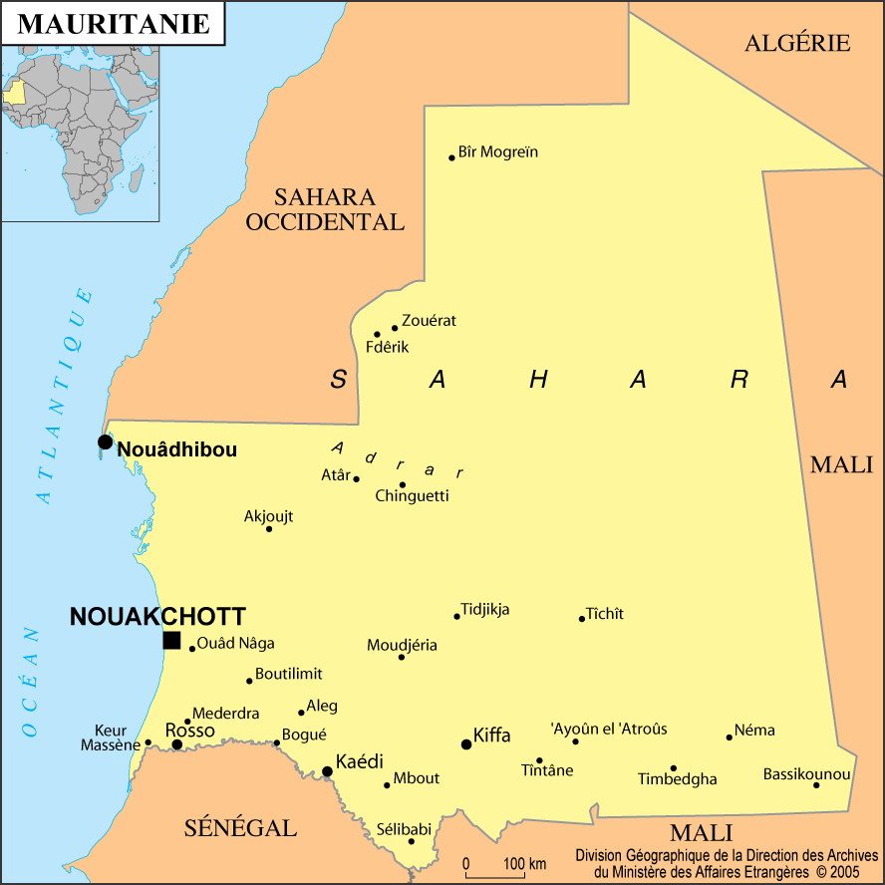
Nouadhibou: a strategic access point

Slide 12
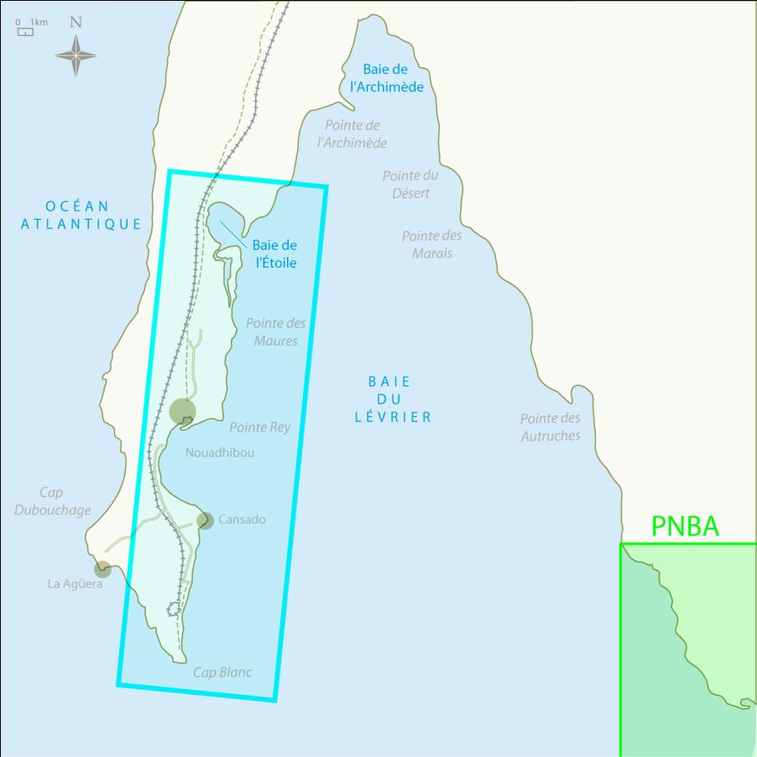
Bay of Nouadhibou: a privileged environment
50 kilomètres

Slide 13
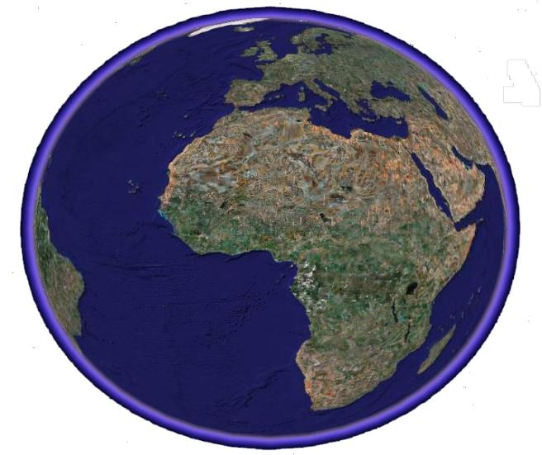
A single maritime site
A Unique natural harbor site between Casablanca and Dakar
Natural channel, self-dredged and stable
Can be developed up to -22 m at the site of Cap Blanc
Bay sheltered from the swell and wind
At the crossroad of major shipping routes (Europe, Asia, Americas)
Between Africa and the Mediterranean
Proximity to Europe and the Americas

Slide 14
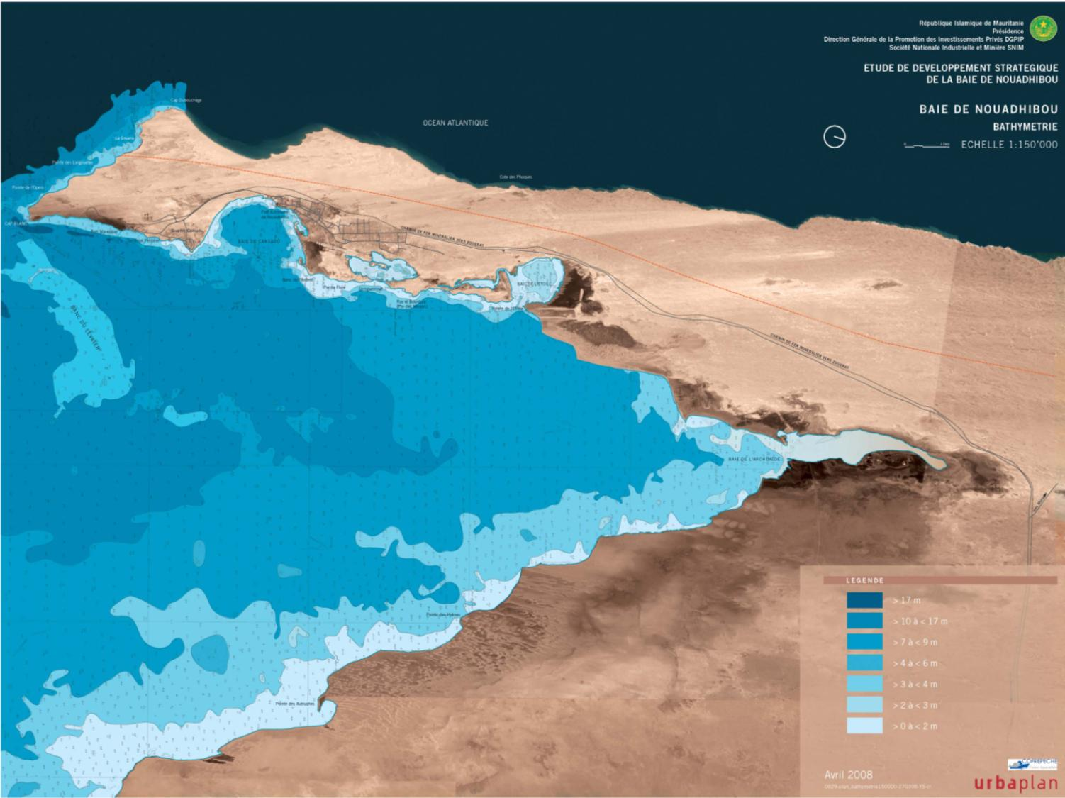
Exceptionally favorable nautical conditions
-7 à -10m
-22m
-10 à -17 m
-2 à -5 m
-7 à -10m
-22 m Oil Tankers
<= -13,5 m Containers Ships
-2 à -5m
- 8 à -12 m Deep Sea fishing
- 5 à - 8 m Industrial Fishing
-2 à -5 m recreational and coastal fishing
17/03/2013
14

Slide 15
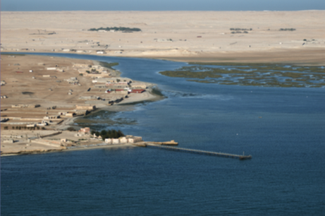
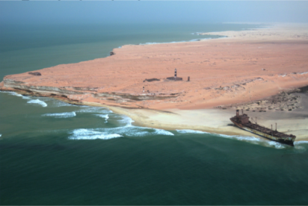
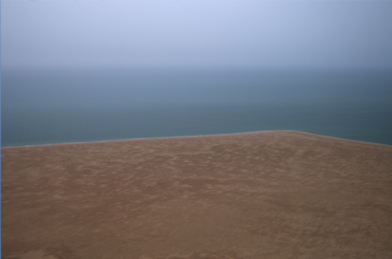
Other major natural advantages
Favorable climate throughout the year (well ventilated with constant temperature)
Quality and diversity of landscapes (sea/ desert)
Virgin and unpolluated area
Exceptional fishery ressources
A rich mining hinterland with a great potential
An exceptional wind power potential

Slide 16
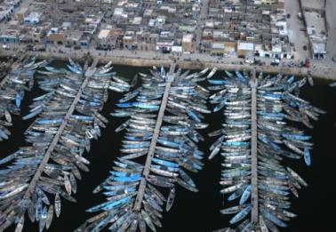
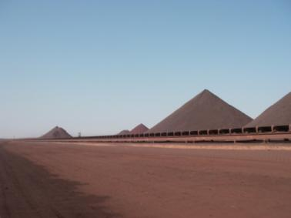
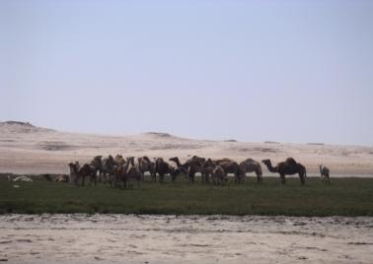
Assets for high growth
Existence of main activities with high growth potential (mining, fisheries)
Energy Solutions
Spaces still available
Existing infrastructure
A strong Government’s commitment to promote the development of Nouadhibou into a competitive pole and a regional hub of world-class

Slide 17
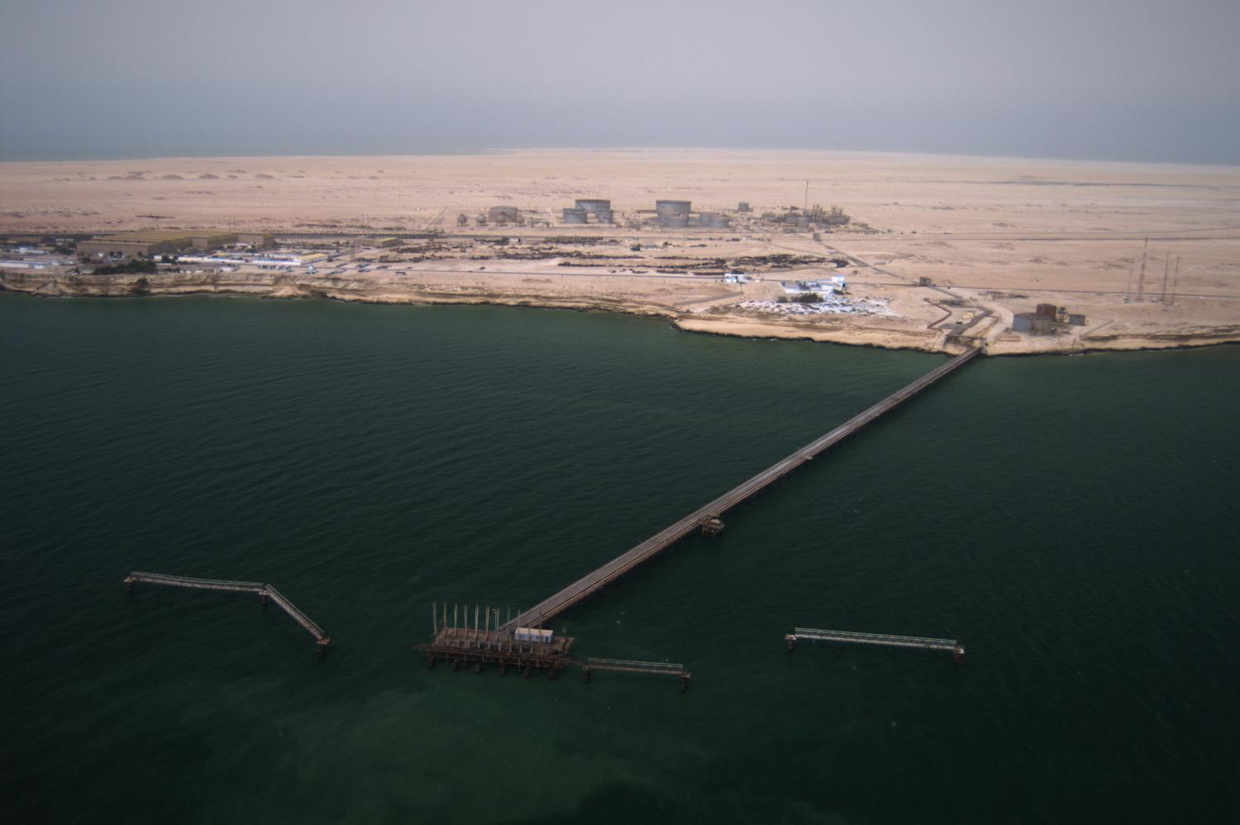

Slide 18
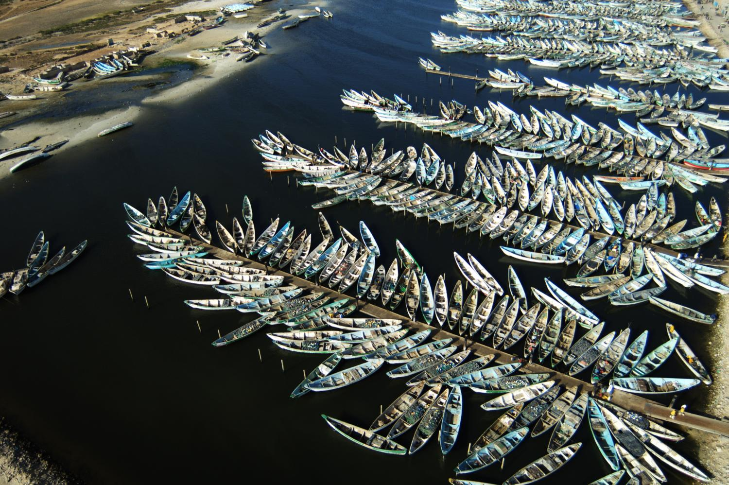

Slide 19
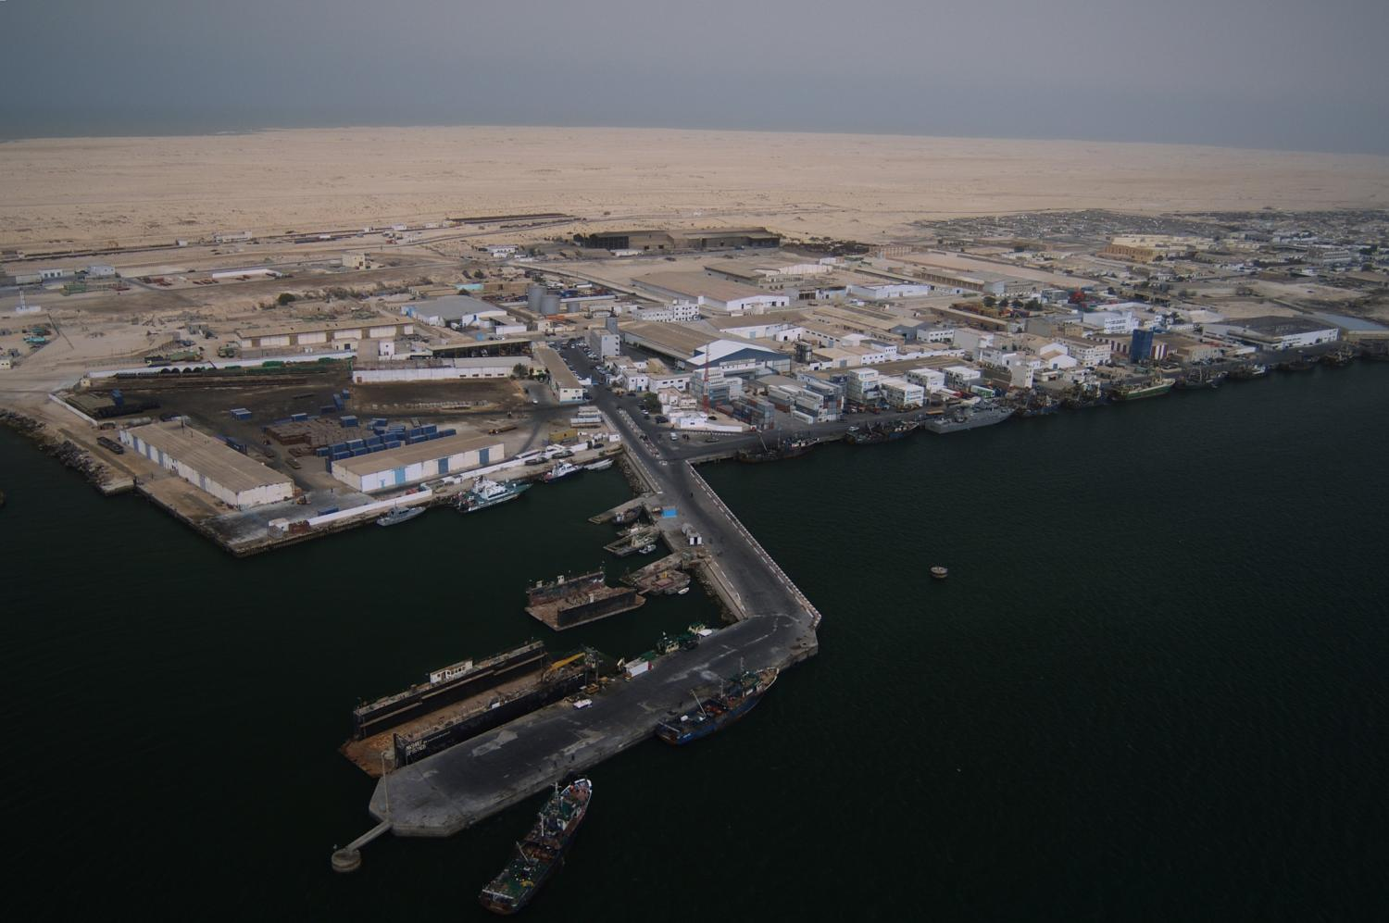

Slide 20
2. An ambitious vision

Slide 21
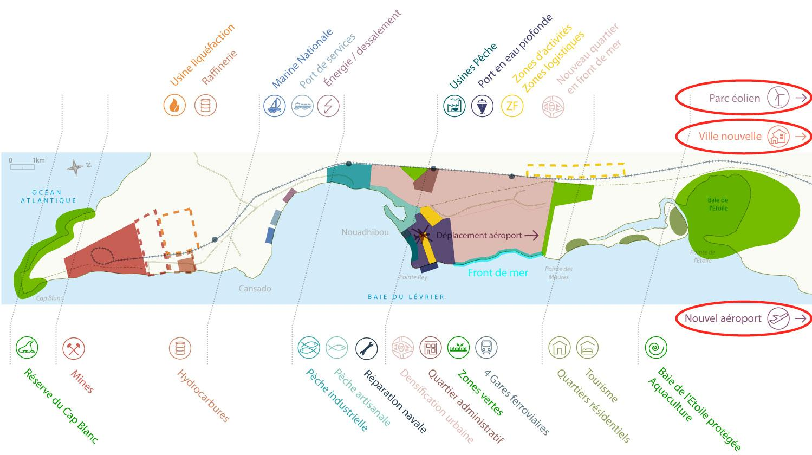
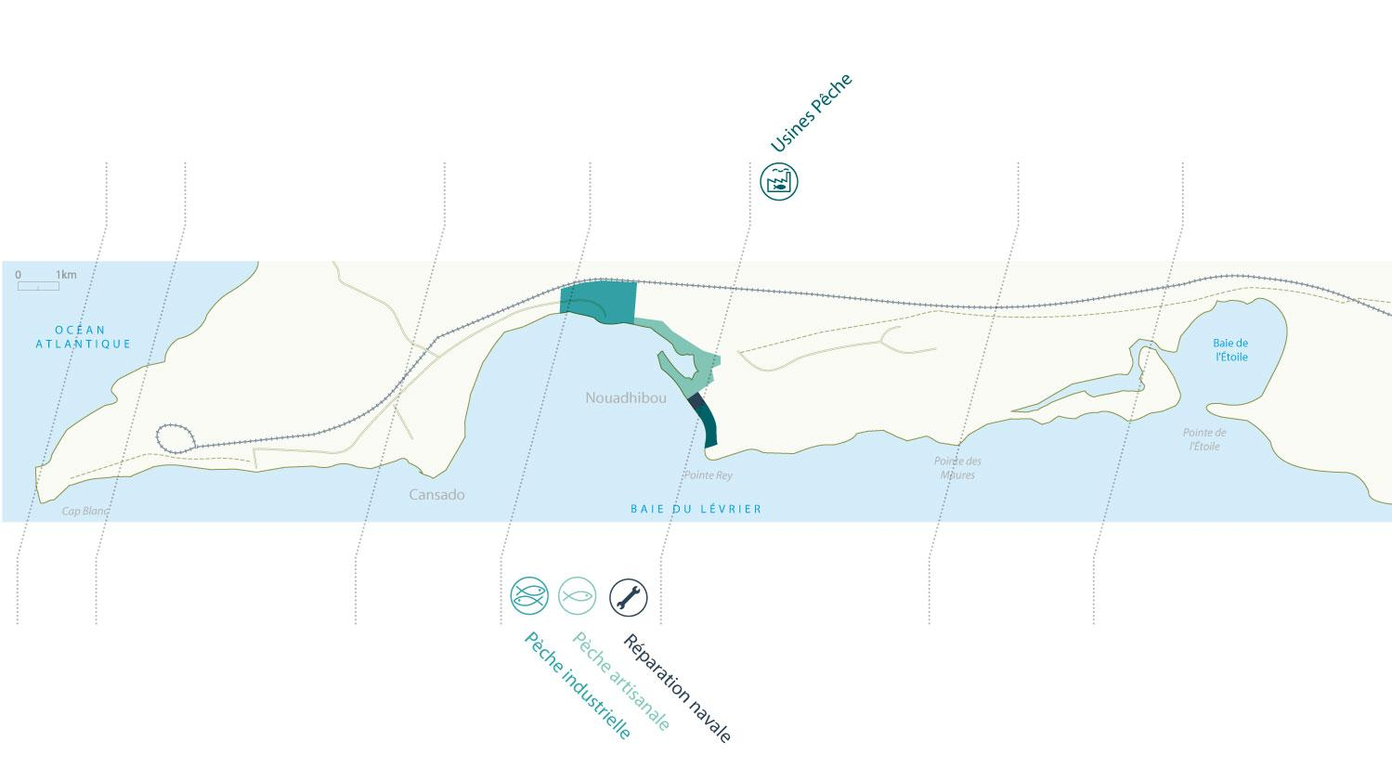
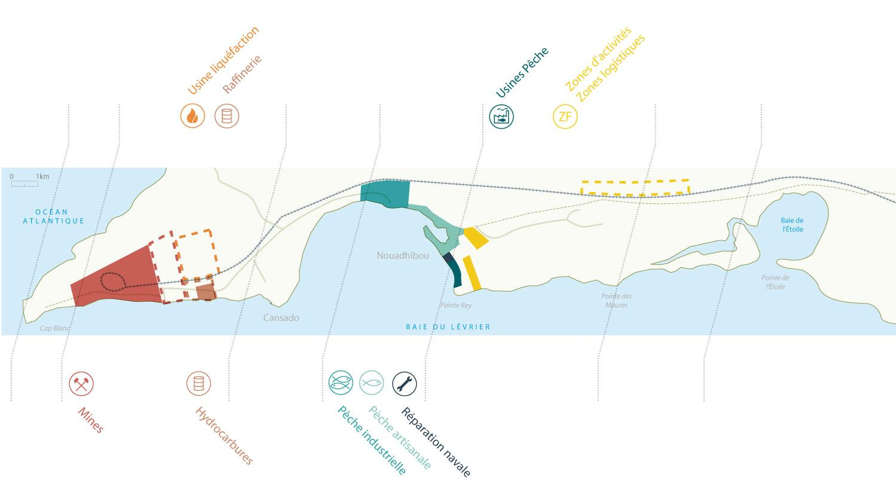
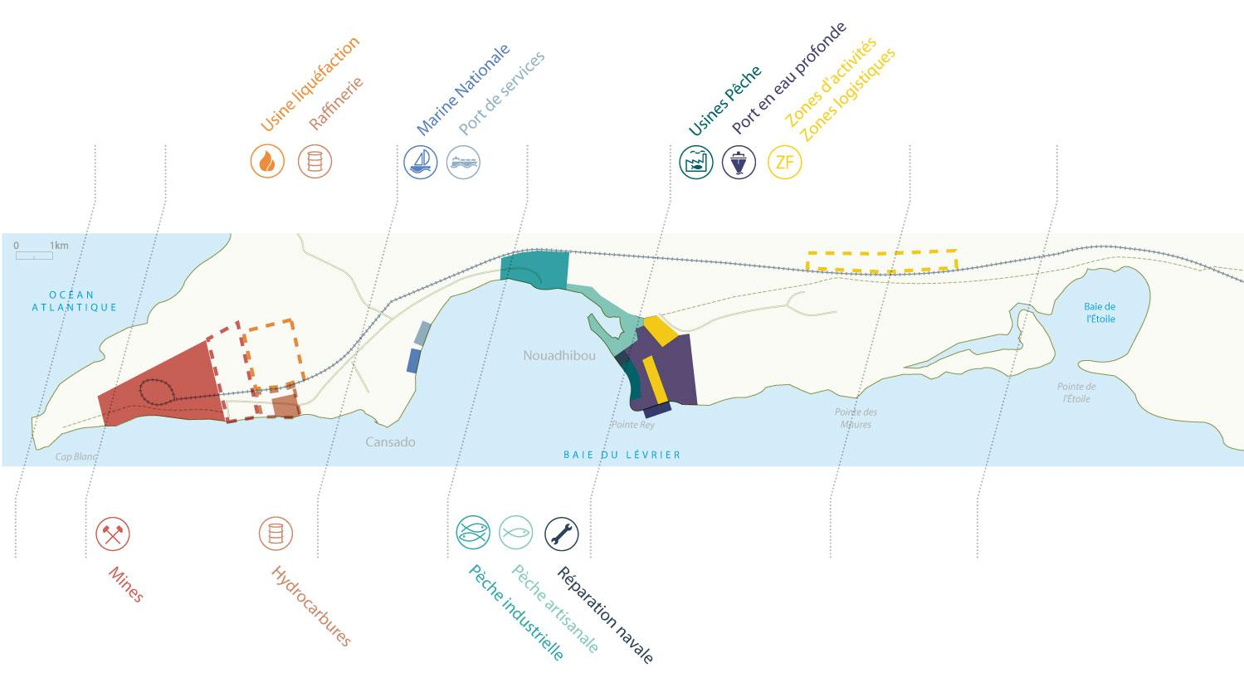
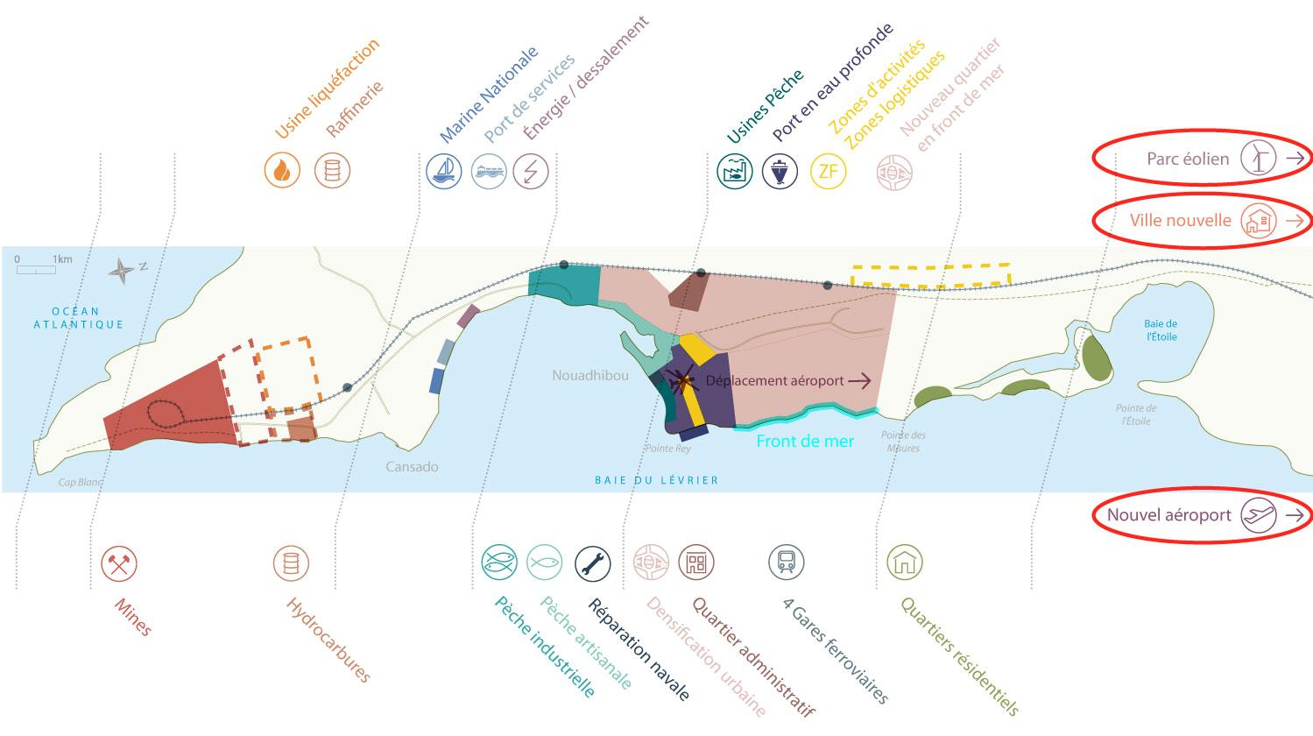
Land Use (As an indication)

Slide 22
Fisheries
Industry
Ports
Urban Sector
Environment
Tourism
Artisanal Fisheries
Mines
Commercial Port (Deep sea)
Urban development
Environment
Tourism
Industrial Fisheries
Hydrocarbons
National Navy
Energy /
Gaz / Wind Power/ Desalination
Fish Farming
Services Port
Fishing Plants
Gaz / NLG
Transshipment Port
Industrial Development Zones
Shipyards

Slide 23
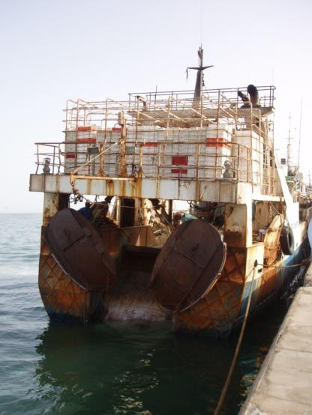
A fishing pole
Creating a fishing pole
Landing and processing capacity Integration of plants for Processing fishery products
Development of shipyard
Accompanying measures
Significant effects
artisanal port + industriel port (pointe Rey)
Potentiel catch:
1 000 000 mt/year
Housing, Jobs

Slide 24
A Power hub
Champ éolien
Hydrocarbons pole
Gaz pole
Electricity production
Storage for local consumption
Eventual construction of a refinery if there are sufficient resources
Local consumption
Possible construction of a liquefaction plant if there are sufficient resources
For 400 000 inabitants or more Cogeneration Wind farm

Slide 25
Mines / Industries
Champ éolien
Mines
Fresh water production
Implantation / reservation for: - industrial areas - Commercial areas - Areas of activity - Logistics areas
70 à 100 millions mt/year + related industries
Sea water desalination plant

Slide 26
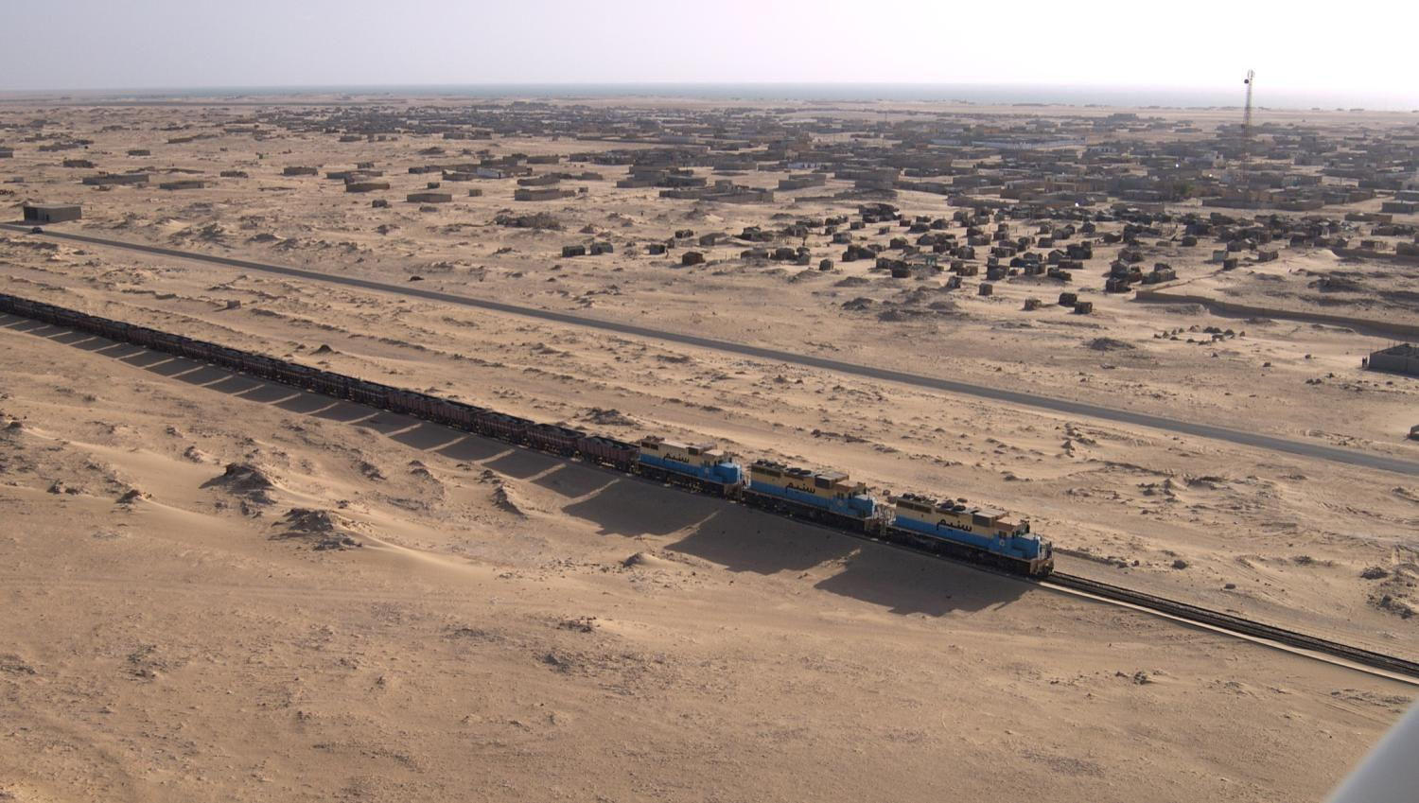

Slide 27
The ports
Construction of Deep Water Port
Port development
National Navy
At the ‘‘pointe Rey’’ :
In the Cansado Bay
In the Cansado Bay

Slide 28
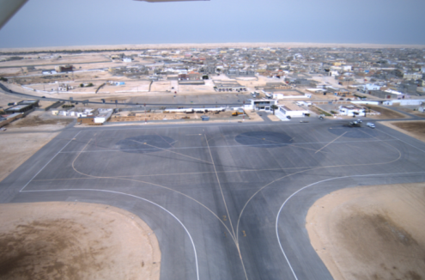
Urban Development
New City
Dimension of the City
Relocation of the airport
Reorganization of the current City
Creating an administrative neighborhood
Creation of residential neighborhood
Creating road and reservation for public transportation and stations
Waste and sanitation management
400 000 inhabitants with option for more for the new city
reservation for the new city
creation of a new neighborhood on the seafront

Slide 29
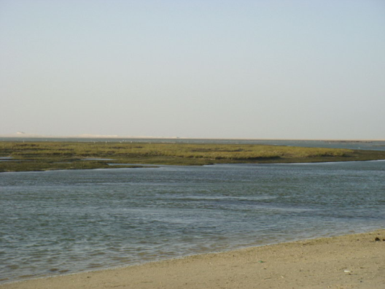
Environment/Tourism
The actions include:
Preservation Reserve Cap Blanc
Protection Bay de l'Etoile with Development of residential ; Shellfish
Development of tourist areas

Slide 30
3. Legal and institutional Framework

Slide 31
Law enacted on January 3, 2013
Implementing decrees taken (Free Zone Authority and Regulation Center)
Incentive Frame (tax, customs, foreign exchange, land, ...)
One-Stop Shop (five days maxi for approval all formalities)
Important powers transferred to the Authority of the Free Zone
Under direct supervision of the Presidency of the Republic
Independent Regulation Center

Slide 32
Institutional Framework
Presidency of the Republic
Superior Council for Strategic Orientation
Chaired by the President of the Republic
Strategic guidelines & Supervision
Regulation Center for the FZ
Nouadhibou FZ Authority
Independent organism
Regulation Committee
Arbitration / Conciliation
Settlement of disputes
Rules of transparency, fairness and impartiality (Authority, Developers, Operators and Investors)
Transfer to the Authority the powers of the Public Administration, the State services, the local authorities and the public institutions
Planning, programming, organization, management and promotion of the Free Zone
Planning, programming, organization, development, implementation and management of development zones (industry, trade, services, housing, tourism, logistics, ...) and infrastructure-support (ports, airport, ...)

Slide 33
Regimes of the Nouadhibou Free Zone
Taxation
* Until the seventh year (included): Total exemption from all taxes * From the 8th to the 15th year (included): reduced rate of 7% tax on industrial and commercial profits * From the 16 th year: ordinary rate of 25% tax on industrial and commercial profits
2. Customs regime * Import: Total exemption from all duties, taxes and charges on imports * Exports: Total exemption from all customs duties and taxes on exports
3. Exchange regime * Freedom of transfer of income or revenus * Freedom of transfer of funds (operations, capital transactions, refunds, ...) * Flexibility (currency accounts with foreign banks, ...)
4. Land Tenure * Ownership and management of the private domain of the State are the responsibility of the Free Zone Authority * Management of the public domain of the State entrusted to the Authority
5. One-Stop-Shop
* Single point of contact; Transparency, Efficiency (approval within 5 days)

Slide 34
4. Multiple investment opportunities

Slide 35
Multiple investment opportunities
Public-private investment and public-private partnership (PPP)
Many sectors are concerned :
Fishery (factories, seaweed farming / shellfish farming, ships, victualling, associated activities, …)
Mines (transformation, transport, sub-contracting, …)
Industries
Infrastructures
Sanitation
Roads
Water/ desalination
Energy (wind energy park, storage, distribution, liquefaction plant, refinery, ….)
Waste processing
Ports and ports services (towing,, ….)
Airport
Urban transport
Housing, urban equipment (services, hospitals, etc.)
Tourism / leisures
Etc.

Slide 36
Quick Wins for Indian Companies
Development operations (Industry, Logistics, …)
Being a fishing port, many fish processing industries can be developed in the area for exports to Mediterranean, Africa, lower rim of Europe, South America and USA;
Textile Industry (being close to the largest cotton producing countries, Mali and Burkina Faso);
Tourism and Hotel industy on Atlantic Shores;
Tiny and Cottage Industries;
Nouadhibou is declared as high wind potentiel area, suitable to establish Wind Energy Park, increasing the energy availability and also achieving environmental benefits, by producing Green Energy.

Slide 37
ANNOUNCEMENT
Event: Conference ‘‘Great Investment opportunities in Mauritania & Launching the Nouadhibou Free Zone’’
Organizers: Ministry of Economic Affairs and Development & The Nouadhibou Free Zone Authority
Date: June 24th and 25th, 2013
Location: Nouakchott and Nouadhibou (Mauritania)
Registration: will be specified shortly

